Slide 1
Predicting self-regulated learning support needs
Rick Dijkstra, dr. Max Hinne, prof. dr. Eliane Segers, Josh Ring, prof. dr. Inge Molenaar

Slide 2
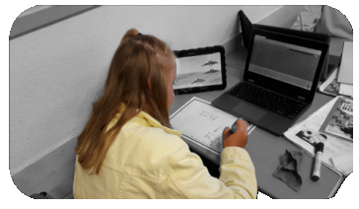
Self-regulated learning support
Introduction

Slide 3
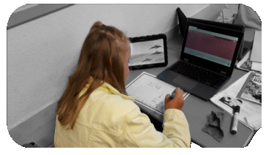
Self-regulated learning support
Introduction

Slide 4

Self-regulated learning support
Introduction

Slide 5
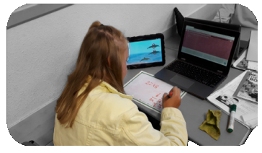
Self-regulated learning support
Introduction

Slide 6
AIMs:
Detect SRL support needs
So that we can
2) Predict SRL support needs during learning

Slide 7
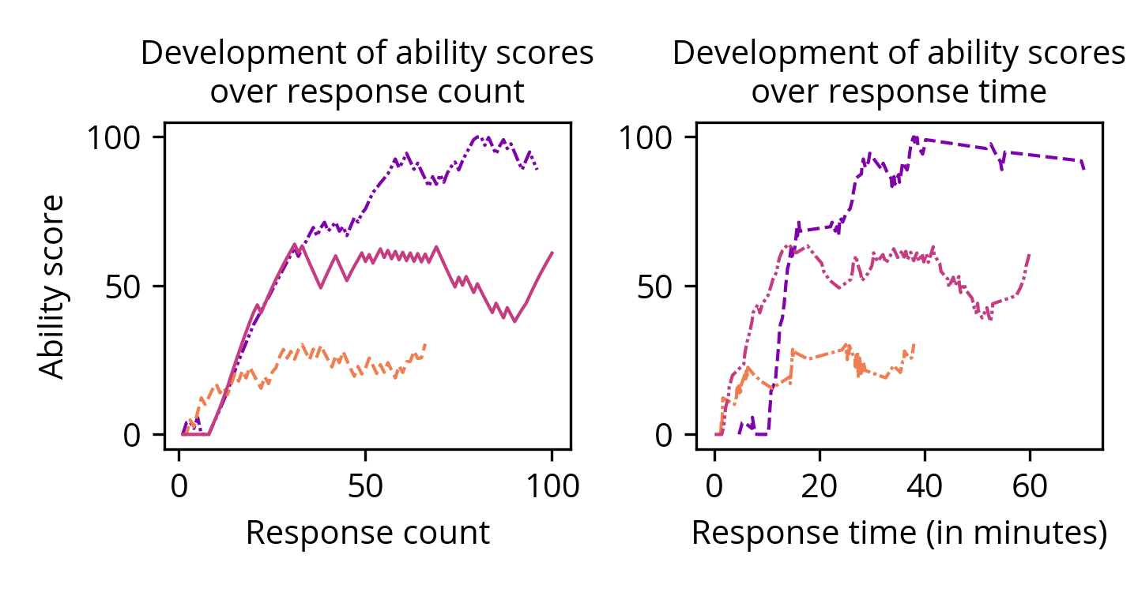
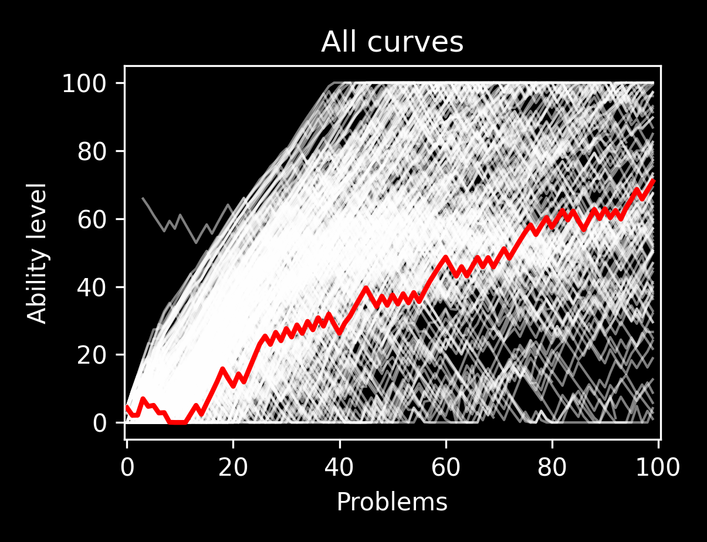
Log data
Methods
[2]
Ability student goes up
Ability student goes down
Correct?
Incorrect?
Responses

Slide 8
Measurements
Methods
Pre test
Number of correct answers
4 days with 30 minutes of practice
First 3 days one learning goal each, 4th day repetition
Accuracy (= Percentage of correct responses)
Effort (= Total number of responses)
Learning curve
Post test
Number of correct answers

Slide 9
1) Detecting SRL support needs: Clustering [1]
Methods
Bayesian non-parametric clustering
Learn the amount of clusters from the data
Learn the shape of the clusters from the data
Cluster based on the whole ability curve
Identify support needs for clusters
Based on learning outcomes and process measures

Slide 10
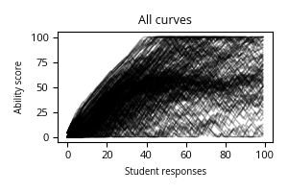
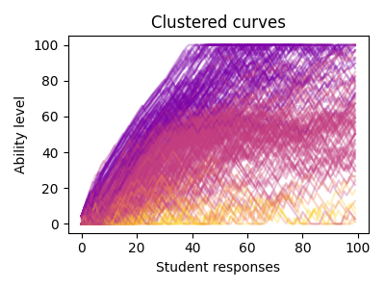
1) Detecting SRL support needs: Clustering [1]
Methods
Bayesian non-parametric clustering
Learn the amount of clusters from the data
Learn the shape of the clusters from the data
Cluster based on the whole ability curve
Identify support needs for clusters
Based on learning outcomes and process measures

Slide 11
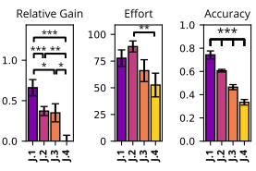
1) Detecting SRL support needs: Clustering
Methods
Bayesian non-parametric clustering
Learn the amount of clusters from the data
Learn the shape of the clusters from the data
Cluster based on the whole ability curve
Identify support needs for clusters
Based on learning outcomes and process measures
Support needs 1
Support needs 2
Support needs …
Support needs N

Slide 12
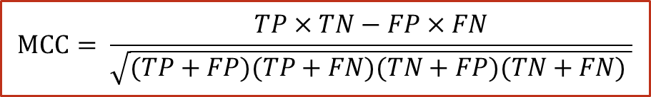
2) Predicting SRL support needs
Methods
Assign to cluster based on partial curve
Partial curve: the data available at a certain point in learning
Correct prediction if partial curve classification is the same as the full curve classification
Accuracy as Matthews Correlation Coefficient (MCC)
Balanced for different class sizes.
Range from -1 to 1; Aim for 0.75
$$MCC= \frac{TP×TN−FP×FN}{\sqrt{(TP+FP)(TP+FN)(TN+FP)(TN+FN) }}$$

Slide 13
Results
-
1) Detecting

Slide 14
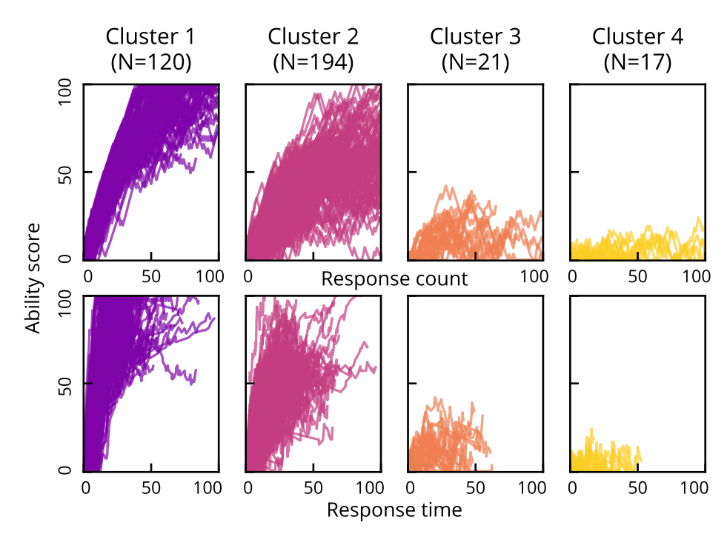
1) Detecting - Clusters
Results
Four clusters
Plotted for both input dimensions
Different sizes
Cluster 3 and 4 looking similar

Slide 15
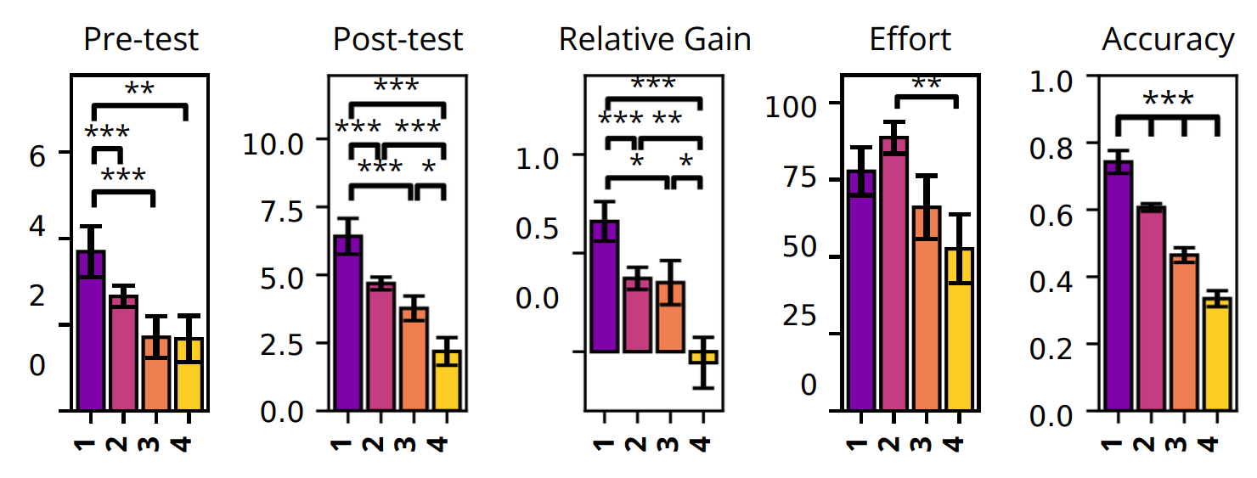
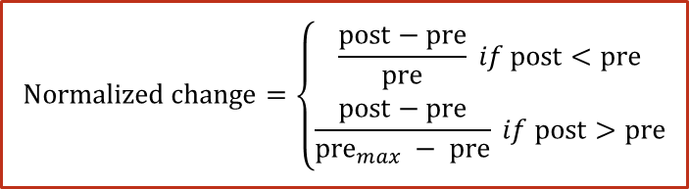
1) Detecting - SRL support needs
Results
Normalized change
1: Masters
(Minimal support needs)
2: Risers
(Moderate support needs)
3: Strugglers
(Extensive support needs)
4 Trailers
(Extensive support needs)
$$Normalized change=\left\{\begin{aligned}\frac{post−pre}{pre} if post<pre \\ \frac{post−pre}{pre_{max} − pre} if post>pre\end{aligned}\right.$$

Slide 16
Results
-
2) Predicting

Slide 17
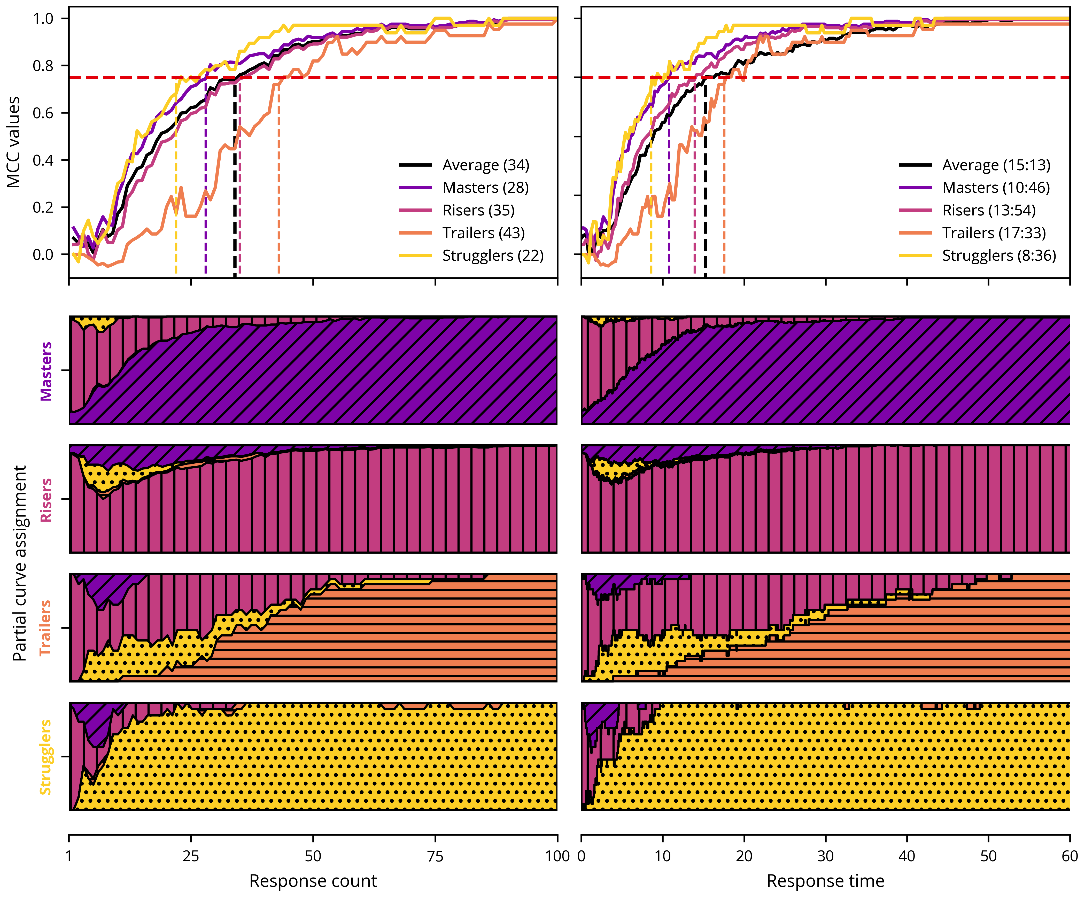
2) Predicting - Accuracy
Results
Average responses
in a lesson: 71
One lesson: 30 minutes
22
34
43
8:36
15:13
17:33

Slide 18
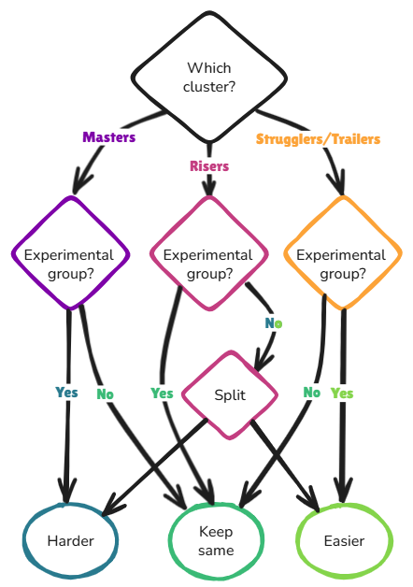
Discussion
Time input is messy, since classrooms are messy.
Prediction makes intervention after 15 minutes possible
Next step: intervention study

Slide 19
Thank you!

Slide 20
References
Dijkstra R., Hinne M., Segers, E., Molenaar I.: Clustering children’s learning behaviour to identify self-regulated learning support needs. Computers in Human Behaviour p.107754 (2023) https://doi.org/10.1016/j.chb.2023.107754
Klinkenberg. S., Straatemeijer, M., van der Maas, H.L.J.: Computer adaptive practice of Maths ability using a new item response model for on the fly ability and difficulty estimation. Computers & Education 57, 1813-1824 (2011). https://doi.org/10.1016/j.compedu.2011.02.003

